Slide 1

Introduction to R
Shyh-Weir Tzang
Asia University
2017/08/14

Slide 2
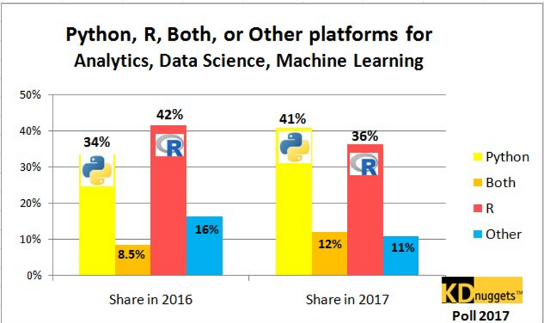
KDnuggets survey

Slide 3
Website
Code School: Try R
Quick-R (Book: Action in R)
R Documentation
Advance R
R-bloggers
Stack Overflow
CRAN Task Views
Systematic investor
https://stat.ethz.ch/mailman/listinfo/r-sig-finance
What is R?

Slide 4
# Recommended readings #####
0. RStudio Cheat Sheet https://www.rstudio.com/resources/cheatsheets/
1. R in Action
http://www.amazon.com/R-Action-Robert-Kabacoff/dp/1935182390/ref=sr_1_1?s=books&ie=UTF8&qid=1399278766&sr=1-1&keywords=r+in+action
2. R for Everyone: Advanced Analytics and Graphics: http://www.amazon.com/Everyone-Advanced-Analytics-Graphics-Addison-Wesley/dp/0321888030
3. Advanced R: http://adv-r.had.co.nz/

Slide 5
CRAN Task Views
CRAN Task Views Bayesian
Bayesian Inference ChemPhys
Chemometrics and Computational Physics ClinicalTrials
Clinical Trial Design, Monitoring, and Analysis Cluster
Cluster Analysis & Finite Mixture Models DifferentialEquations
Differential Equations
Distributions Probability Distributions
Econometrics Econometrics
Environmetrics Analysis of Ecological and Environmental Data
ExperimentalDesign Design of Experiments (DoE) & Analysis of Experimental Data
Finance Empirical Finance
Genetics Statistical Genetics
Graphics Graphic Displays & Dynamic Graphics & Graphic Devices & Visualization
HighPerformanceComputing High-Performance and Parallel Computing with R
MachineLearning Machine Learning & Statistical Learning
MedicalImaging Medical Image Analysis
MetaAnalysis Meta-Analysis
Multivariate Multivariate Statistics
NaturalLanguageProcessing Natural Language Processing
NumericalMathematics Numerical Mathematics
OfficialStatistics Official Statistics & Survey Methodology
Optimization Optimization and Mathematical Programming
Pharmacokinetics Analysis of Pharmacokinetic Data
Phylogenetics Phylogenetics, Especially Comparative Methods
Psychometrics Psychometric Models and Methods

Slide 6
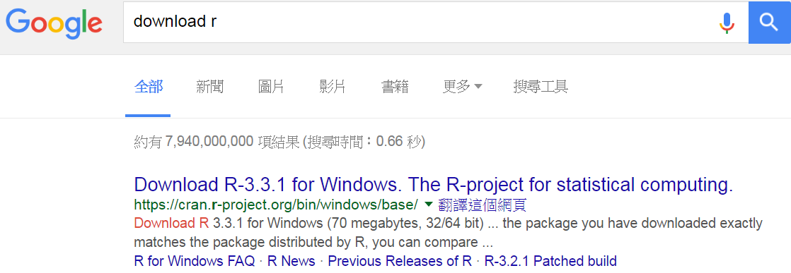
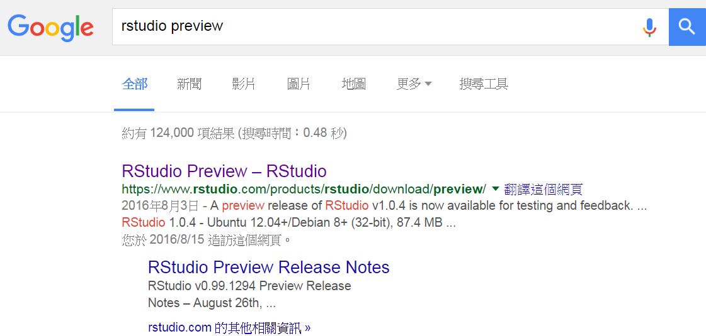
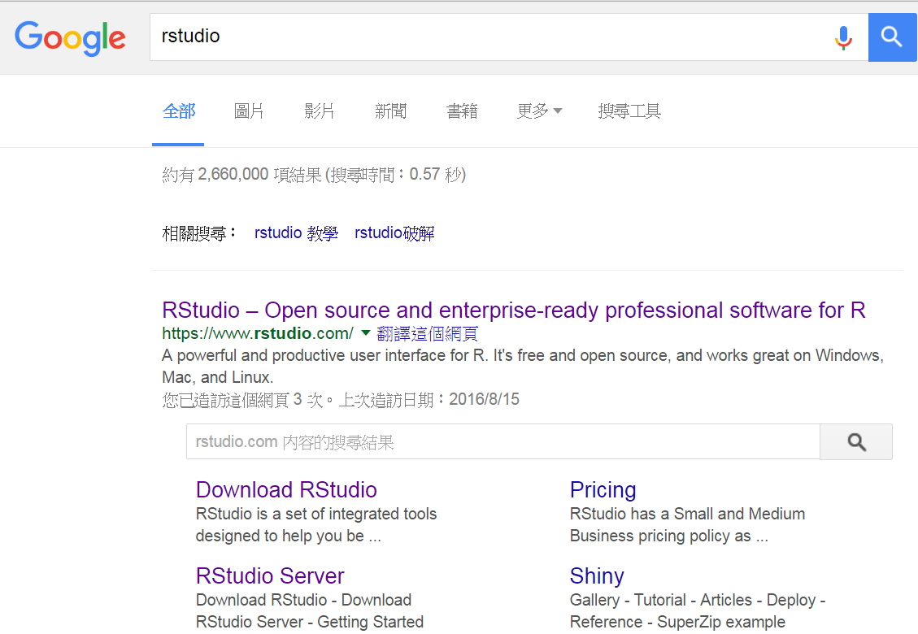
R and RStudio download
This preview edition is more advanced!

Slide 7
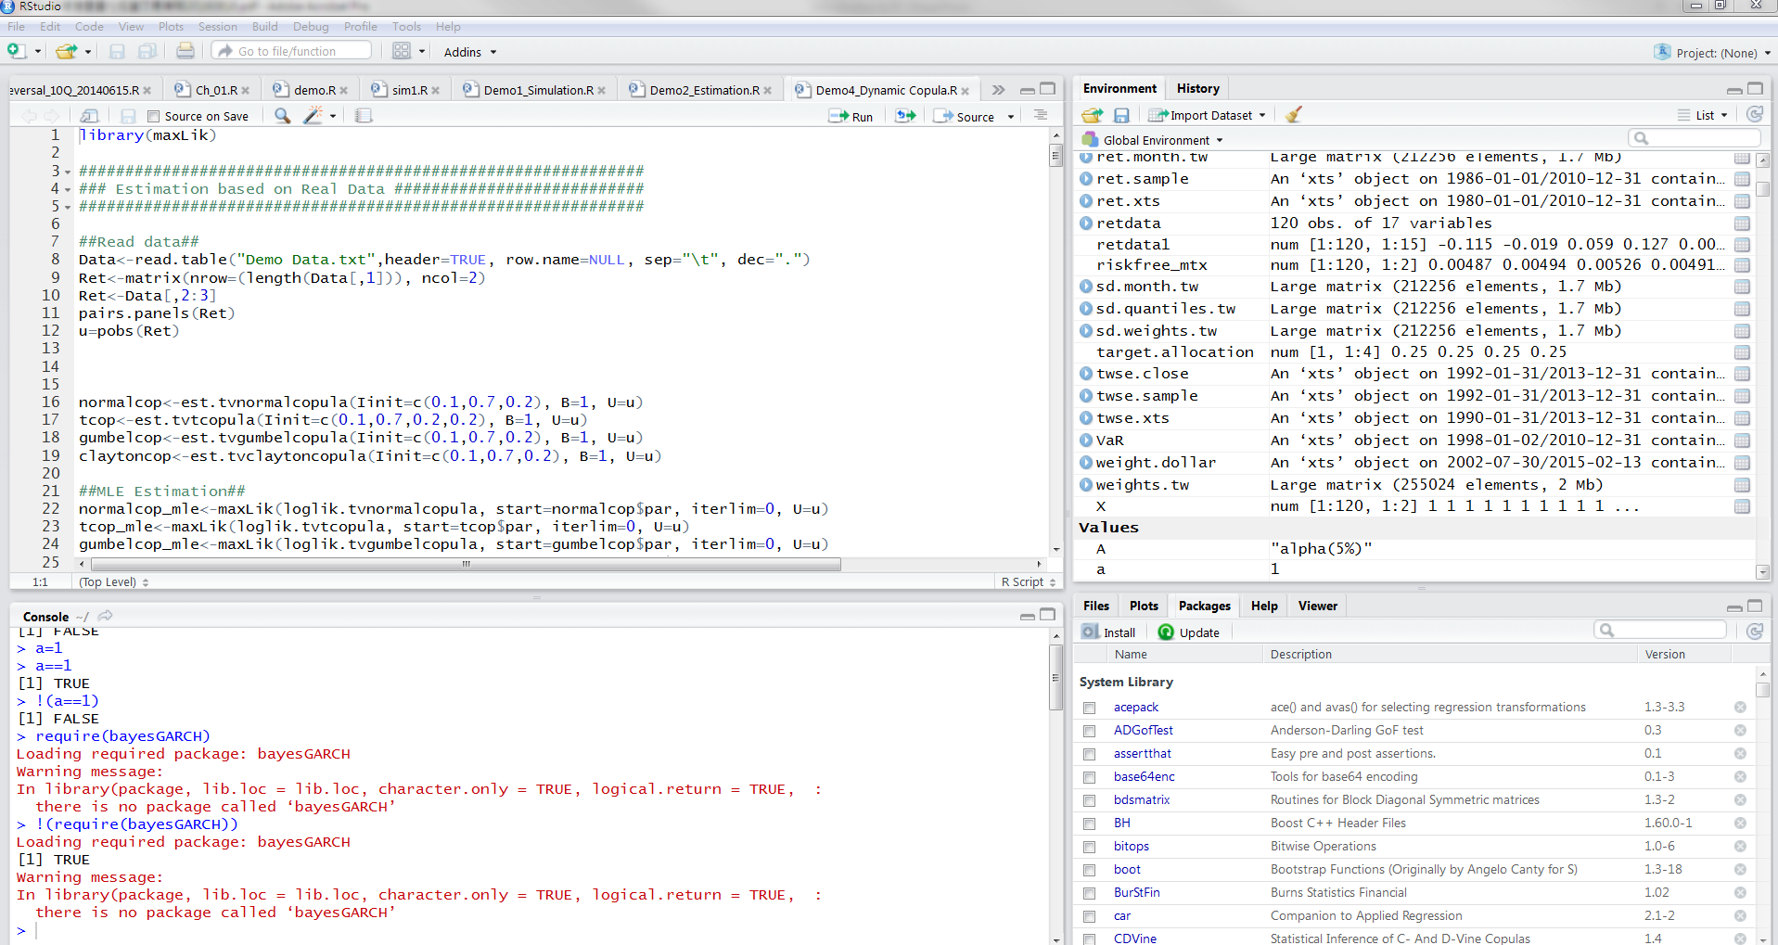
Screenshot of RStudio
Objects and variables
codings
Command output
Files
Plots
Packages
Help

Slide 8
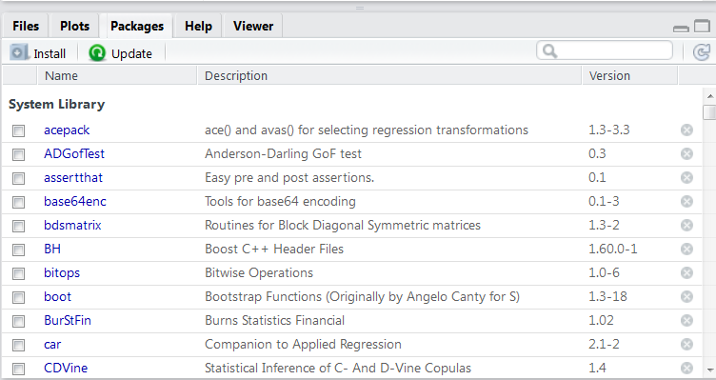
Install packages
ifelse(!require(quantmod),install.packages("quantmod"),library(quantmod))
If this package is not installed, then require(quantmod) will return FALSE. And !require(quantmod) will return TRUE.

Slide 9
Some useful hot keys
Esc ：interrupt current command
Ctrl + L : clear console
Ctrl + Enter : run current line
Ctl + F: find commands
Ctl + Shift + j: find and replace command
Tab: automatically filled
Ctrl + Shift + s : run all lines
Ctrl + Shift + c : comment lines

Slide 10
Data manipulation
Variable types: numeric /character/logical/complex / factor / ordered factor /date/xts/zoo/ …
Data type: list / matrix / vector / array / data.frame / …
Data import & export: csv / txt / xls / xlsx / html / xml / json / …
Procedure control:
conditional (if-else / ifelse / …)
looping (for / while)
advanced (apply)
Data processing:
Index
Sort
Subset
Appending
Aggregating / Grouping

Slide 11
Variable type
ls(): returns the names of objects in environment
rm: remove objects from environment
rm(list=ls()): remove all variabless
mode(), class(), str()
is.numeric(), is.character(), is.logical(), is.complex(), is.na()…
a<-3
b<-’character’ or B<-”character”
Logical c<-TRUE or T / FALSE or F
Complex d<-3+2i
abcd.list<-list(a, b, c, d)
Create named list
Name.list<-list(a=a, b=b, c=c, d=d)

Slide 12
Vector
Vectors=>Three common properties:
Type, typeof(), what it is.
Length, length(), how many elements it contains.
Attributes, attributes(), additional arbitrary metadata.

Slide 13
vector
vector1<-1:10
vector2<-seq(1,100, length=10)
vec_string <- c(’A’, ’B’, ’C’)
group1<-rep(1:3, times = c(8,10,9))
group2<-factor(group1)
set.seed(10) # reproduce same simulated values
vec_random1<- runif(5)
vec_max <- max(vec_random1)
vec_min <- min(vec_random1)
vec_random2<- sample(c(’A’,’B’), size=10, replace=TRUE)
vector_0<- numeric(10)

Slide 14
vector
seq(0, 1, length.out = 11)
[1] 0.0 0.1 0.2 0.3 0.4 0.5 0.6 0.7 0.8 0.9 1.0
seq(1, 9, by = 2) # matches 'end'
[1] 1 3 5 7 9
seq(1, 9, by = pi) # stays below 'end'
[1] 1.000000 4.141593 7.283185
seq(1, 6, by = 3)
[1] 1 4
seq(1.575, 2.125, by = 0.05)
[1] 1.575 1.625 1.675 1.725 1.775 1.825 1.875 1.925 1.975 2.025 2.075 2.125
seq(17) # same as 1:17, or even better seq_len(17)
[1] 1 2 3 4 5 6 7 8 9 10 11 12 13 14 15 16 17

Slide 15
vector
?Rep()
rep(1:4, 2)
[1] 1 2 3 4 1 2 3 4
rep(1:4, each = 2)
[1] 1 1 2 2 3 3 4 4 # not the same. rep(1:4, c(2,2,2,2)) # same as second.
rep(1:4, c(2,1,2,1))
[1] 1 1 2 3 3 4
rep(1:4, each = 2, len = 10) # 8 integers plus two recycled 1's.
[1] 1 1 2 2 3 3 4 4 1 1
rep(1:4, each = 2, times = 3) # length 24, 3 complete replications
[1] 1 1 2 2 3 3 4 4 1 1 2 2 3 3 4 4 1 1 2 2 3 3 4 4
rep(1, 40*(1-.8)) # length 7 on most platforms rep.int(x, times) =>Non-integer values of times will be truncated towards zero. If times is a computed quantity it is prudent to add a small fuzz or use round. And analogously for each.
rep(1, 40*(1-.8)+1e-7) # better
a<-40*(1-.8)
all.equal(a, as.integer(a))
[1]"Mean relative difference: 0.125"

Slide 16
vector: all.equal(x,y), identical(x,y)
all.equal(x, y) is a utility to compare R objects x and y testing ‘near equality’.
If they are different, comparison is still made to some extent, and a report of the differences is returned.
Do not use all.equal directly in if expressions—either use isTRUE(all.equal(....)) or identical if appropriate.
sqrt(2)^2==2
[1] FALSE
identical(sqrt(2)^2, 2)
[1] FALSE
isTRUE(all.equal(sqrt(2)^2, 2))
[1] TRUE
all.equal(sqrt(2)^2, 2,tolerance = 1e-12)
[1] TRUE
all.equal(sqrt(2)^2, 2,tolerance = 1e-20)
[1] "Mean relative difference: 2.220446e-16"

Slide 17
Matrix
vector<-1:12
my_matrix<-matrix(vector, nrow=3, ncol=4, byrow=FALSE)
# default: byrow=FALSE
matrix(data=NA, nrow=3, ncol=2) # create an empty matrix
a <- matrix(1:6, ncol = 2, nrow = 3)
[,1][,2]
[1,] 1 4
[2,] 2 5
[3,] 3 6
Check=> a[2:3,] ; a[c(1,3),1] ; a[a[,2]>=5,]
a[a<=5] <-0; ifelse(a>3, 1, 0)

Slide 18
Matrix
A<- matrix(c(3,1,5,2), 2, 2,)
t(A)%*%A
b <- matrix(c(4,1), ncol = 1)
x <- solve(A, b)

Slide 19
list
A list is a data structure that can hold any number of any types of other data structures. If you have vector, a dataframe, and a character object, you can put all of those into one list object like so:
# create three different classes of objects
vec <- 1:4
df <- data.frame(y = c(1:3), x = c("m", "m", "f"))
char <- "Hello!" # add all three objects to one list using list() function
list1 <- list(vec, df, char) # print list list1
str(list1) List of 3
$ : int [1:4] 1 2 3 4
$ :'data.frame': 3 obs. of 2 variables: ..
$ y: int [1:3] 1 2 3 ..
$ x: Factor w/ 2 levels "f","m": 2 2 1
$ : chr "Hello!"
> list1[[1]] [1] 1 2 3 4
xlist<-list(a=1:4, b="b", c=c(T, F, T,TRUE), d=c(3.34,3,4, 5.9))

Slide 20
Data Frame
Similar to excel format
2-dimension with the same data type within each column
Different columns allow different data types.
colnames(); rownames();
length(); nrow();

Slide 21
Data frame
L3 <- LETTERS[1:3]
fac <- sample(L3, 4, replace = TRUE)
d <- data.frame(x = 1, y = 1:4, fac = fac)
all.equal(d[d$y>2,], subset(d, y>2))
 | x | y | fac
1 | 1 | 1 | C
2 | 1 | 2 | B
3 | 1 | 3 | B
4 | 1 | 4 | A

Slide 22
Data Frame
Data frame bootstrap example
>set.seed(10)
>(d <- data.frame(x = 1, y = 1:4, fac = fac))
> xd<-d[sample(nrow(d), 5, replace = TRUE),]
# sample from 1 thru 4 rows by 5 times. If the same row is sampled again, the row names will be changed from integer to decimal.
d xd
 | x | y | fac
1 | 1 | 1 | C
2 | 1 | 2 | B
3 | 1 | 3 | B
4 | 1 | 4 | A
 | x | y | fac
2 | 1 | 2 | B
4 | 1 | 4 | A
1 | 1 | 1 | C
3 | 1 | 3 | B
3.1 | 1 | 3 | B

Slide 23
Data frame
order(xd$y)
[1] 3 1 4 5 2
xd.order<- xd[order(xd$y),]
 | x | y | fac
2 | 1 | 2 | B
4 | 1 | 4 | A
1 | 1 | 1 | C
3 | 1 | 3 | B
3.1 | 1 | 3 | B
 | x | y | fac
1 | 1 | 1 | C
2 | 1 | 2 | B
3 | 1 | 3 | B
3.1 | 1 | 3 | B
4 | 1 | 4 | A

Slide 24
Data variables
 | Homogeneous | Heterogeneous
1-dimension | Vector | List
2-dimension | Matrix | Data frame
N-dimension | Array

Slide 25
Factor
Categorical data: group data
n<-c("A", "B", "B", "C", "D")
nf<-factor(n)
nf
[1] A B B C D
Levels: A B C D
levels(nf)
[1] “A” “B” “C” “D”
table(nf)
nf1<-factor(n, labels='a')
nf2<-factor(n, level=c('A','B','C','D'), ordered=TRUE)

Slide 26
Exercises 1
.
Consider y <- list("a", "b", "c"), write an R statement that will assign new names "one", "two" and "three" to the elements of y.
Let x <- list(a=5:10, c="Hello", d="AA"), write an R statement to add a new item z = "NewItem" to the list x
Create three vectors x,y,z with integers and each vector has 3 elements. Combine the three vectors to become a 3×3 matrix A where each column represents a vector. Change the row names to a,b,c.
Create a vector with 12 integers. Convert the vector to a 4*3 matrix B using matrix(). Please change the column names to x, y, z and row names to a, b, c, d
Convert A into data.frame and then convert it back to matrix. (hint: use data.frame() and as.matrix())

Slide 27
Exercises 1 answers
.
Consider y <- list("a", "b", "c"), write an R statement that will assign new names "one", "two" and "three" to the elements of y.
y <- list("a", "b", "c") names(y) <- c("one", "two", "three")
Let x <- list(a=5:10, c="Hello", d="AA"), write an R statement to add a new item z = "NewItem" to the list x
x <- list(a=5:10, c="Hello", d="AA") x$z <-"New Item"
Create three vectors x,y,z with integers and each vector has 3 elements. Combine the three vectors to become a 3×3 matrix A where each column represents a vector. Change the row names to a,b,c.
x<-c(1,2,3) y<-c(4,5,6) z<-c(7,8,9) A<-cbind(x,y,z) rownames(A)<-c("a","b","c") ####if combined by rows A<-rbind(x,y,z)
Create a vector with 12 integers. Convert the vector to a 4*3 matrix B using matrix(). Please change the column names to x, y, z and row names to a, b, c, d
b<-c(1:12) B<-matrix(b, 4, 3, dimnames = list(c("a","b","c","d"),c("x", "y", "z")))
Convert A into data.frame and then convert it back to matrix. (hint: use data.frame() and as.matrix())

Slide 28
Exercises 2
# Poker and roulette winnings from Monday to Friday
poker_vector <- c(140, -50, 20, -120, 240)
roulette_vector <- c(-24, -50, 100, -350, 10)
days_vector <- c("Monday", "Tuesday", "Wednesday", "Thursday", "Friday")
names(poker_vector) <- days_vector
names(roulette_vector) <- days_vector
# Which days did you make money on poker?
# Print out selection_vector
# Select from poker_vector these days

Slide 29
Exercises 2 answers
# Poker and roulette winnings from Monday to Friday
poker_vector <- c(140, -50, 20, -120, 240)
roulette_vector <- c(-24, -50, 100, -350, 10)
days_vector <- c("Monday", "Tuesday", "Wednesday", "Thursday", "Friday")
names(poker_vector) <- days_vector
names(roulette_vector) <- days_vector
# Which days did you make money on poker?
selection_vector <- poker_vector > 0
# Print out selection_vector
selection_vector
# Select from poker_vector these days
poker_winning_days <- poker_vector[selection_vector]

Slide 30
Exercises 3
# Gender vector
gender_vector <- c("Male", "Female", "Female", "Male", "Male")
print(gender_vector)
print(is.factor(gender_vector))
# Convert gender_vector to a factor
print(factor_gender_vector)

Slide 31
Exercises 3 answers
# Gender vector
gender_vector <- c("Male", "Female", "Female", "Male", "Male")
print(gender_vector)
"Male" "Female" "Female" "Male" "Male"
print(is.factor(gender_vector))
[1] FALSE
# Convert gender_vector to a factor
factor_gender_vector <- factor(gender_vector)
print(factor_gender_vector)
[1] Male Female Female Male Male
Levels: Female Male

Slide 32
Exercises 4: mtcars dataset
Subset the vector, “mtcars[,1]“, for values greater than “15.0“.
Subset the dataframe, “mtcars” for rows with “mpg” greater than , or equal to, 21 miles per gallon.
Subset “mtcars” for rows wih “cyl” less than “6“, and “gear” exactly equal to “4“.

Slide 33
Exercises 4: mtcars dataset - answers
Subset the vector, “mtcars[,1]“, for values greater than “15.0“.
subset(mtcars[,1], mtcars[,1] > 15.0)
Subset the dataframe, “mtcars” for rows with “mpg” greater than , or equal to, 21 miles per gallon.
subset(mtcars, mpg >= 21)
Subset “mtcars” for rows wih “cyl” less than “6“, and “gear” exactly equal to “4“.
subset(mtcars, cyl < 6 & gear == 4)

Slide 34
Control commands: apply, lapply, sapply
apply for matrix: When you want to apply a function to the rows or columns of a matrix (and higher-dimensional analogues); not generally advisable for data frames as it will coerce to a matrix first.
apply(matrix(1:6,nrow=2),1,sum) # => 9 12
apply(matrix(1:6,nrow=2),2,sum) # => 3 7 11
Practice:
dataset1 <- cbind(observationA = 16:8, observationB = c(20:19, 6:12))
Using apply(), find the row means of dataset1
Use apply() to sort the columns of dataset1
Using apply(), find the product of dataset1 rows
Create a function: DerivativeFunction <- function(x) { log10(x) + 1 } and
apply “DerivativeFunction” on the rows of dataset1

Slide 35
Control commands: apply, lapply, sapply
apply for matrix: When you want to apply a function to the rows or columns of a matrix (and higher-dimensional analogues); not generally advisable for data frames as it will coerce to a matrix first.
apply(matrix(1:6,nrow=2),1,sum) # => 9 12
apply(matrix(1:6,nrow=2),2,sum) # => 3 7 11
Practice:
dataset1 <- cbind(observationA = 16:8, observationB = c(20:19, 6:12))
Using apply(), find the row means of dataset1 apply(dataset1, 1, mean)
Use apply() to sort the columns of dataset1 apply(dataset1, 2, sort)
Using apply(), find the product of dataset1 rows apply(dataset1, 1, prod)
Required function: DerivativeFunction <- function(x) { log10(x) + 1 } and
apply “DerivativeFunction” on the rows of dataset1 apply(dataset1, 1, DerivativeFunction)

Slide 36
Control commands: apply, lapply, sapply
Reference: https://rollingyours.wordpress.com/category/r-programming-apply-lapply-tapply/
lapply or sapply for list (apply a function over a list or vector)
lapply(list(matrix(1:6,nrow=2),1:3),sum) # return list
[[1]]
[1] 21
[[2]]
[2] 6
sapply(list(matrix(1:6,nrow=2),1:3),sum) # return vector
[1] 21 6

Slide 37
Control commands: tapply
tapply for factor: tapply is similar in spirit to the split-apply-combine functions that are common in R (aggregate, by, ave, ddply, etc.)
tapply(object, list/factor, fun)
x =1:10
x[3] <-NA
y=sample(letters[4:6], 10, replace=T)
[1] "d" "f" "f" "d" "e" "f" "f" "e" "f" "f"
tapply(x,y,sum,na.rm=T)
d e f
5 13 34

Slide 38
Control commands: tapply
# data(mtcars)
# Get the mean MPG by Transmission
tapply(mtcars$mpg, mtcars$am, mean)
# Get the mean MPG for Transmission grouped by Cylinder
aggregate(mpg~am+cyl,data=mtcars,mean)

Slide 39
Control commands: mapply
For when you have several data structures (e.g. vectors, lists) and you want to apply a function to the 1st elements of each, and then the 2nd elements of each, etc., coercing the result to a vector/array as in sapply.
Apply a function to multiple list or vector
mapply(sum, 1:5, 1:5, 1:5)
[1] 3 6 9 12 15
mapply(rep, 1:4, 4:1)
[[1]]
[1] 1 1 1 1
[[2]]
[1] 2 2 2
[[3]]
[1] 3 3
[[4]]
[1] 4

Slide 40
When data is *.xls or *.xlsx
gdata supports the xlsx format
>install.packages(pkgs="gdata")
>library(gdata)
>df <- read.xls("<name of your file.xls>", perl="<location of perl.exe file on your pc")
XLConnect package
>install.packages(pkgs="XLConnect")
>library(XLConnect)
>df <- readWorksheetFromFile("<file name and extension>", sheet=1, startRow = 4, endCol = 2)
xlsx Package
>library(xlsx)
>df <- read.xlsx("<name and extension of your file>", sheetIndex = 1)

Slide 41
When data is *.csv or *.txt
df <- read.table("<FileName>.txt", header = TRUE)
df <- read.csv("<name and extension of your file>", header = TRUE, quote="\"", stringsAsFactors= TRUE, strip.white = TRUE)
write.table; write.csv
write.zoo

Slide 42
Example
head(iris)
# write to a file
write.table(iris, file='iris.csv',sep=',')
# or, more concisely:
write.csv(iris, file='iris.csv')
data <- read.table(file='iris.csv',header = TRUE, sep=',')
# or, more concisely:
data <- read.csv(file='iris.csv')
# if you don't want to type in the path
data <- read.table(file=file.choose(),sep=',')

Slide 43
IO (input and output)
Q: let x <- data.frame(a=1:5, b=5:1).
a. Save x to disk using write.csv() and write.table(). Experiment with the diﬀerent options.
b. Use read.csv() and read.table() to read the ﬁle(s) you wrote in a.
c. Repeat a and b using save() and load() functions.
d. Use scan() to read the ﬁle(s) you wrote in a.
e. Use readline() to read line of strings

Slide 44
Control flow
if (condition){expressions} elseif (condition){expressions} else {expression}
x <- 0
if (x < 0) {
print("Negative number") }
else if (x > 0)
{ print("Positive number") }
else print("Zero")
#
[1] "Zero"
Ifelse(condition,expression if right, expression if wrong)
a <- c(5,7,2,9)
ifelse(a %% 2 == 0,"even","odd")
#
[1] "odd" "odd" "even" "odd"

Slide 45
Control flow
for (index in range(1:n)) {expression}
x=0
for (i in (1:10)) {
x=x+i
if (i == 10) {print (x)}
}
while (condition){expression}
i <- 1
while (i < 6) {print(i) i = i+1}
#
[1] 1
[1] 2
[1] 3
[1] 4
[1] 5

Slide 46
Control flow
next: when we want to skip the current iteration of a loop without terminating it
x <- 1:5
for (val in x) {
if (val == 3){ next }
print(val) }
#
[1] 1
[1] 2
[1] 4
[1] 5

Slide 47
Control flow
Break is used inside a loop to stop the iterations and flow the control outside of the loop.
x <- 1:5
for (val in x) {
if (val == 3){ break }
print(val)
}
#
[1] 1
[1] 2

Slide 48
Exercise
Print out the sum of sequence 1 through 50 using loop.

Slide 49
Exercise
Print out the sum of sequence 1 through 50 using loop.
x=0
for (i in 1:50){
x=x+i}
print(x)

Slide 50
Function()
name.of.function <- function(argument1, argument2) {
statements
return(something)
}
square.it <- function(x) {
square <- x * x
return(square)
}

Slide 51
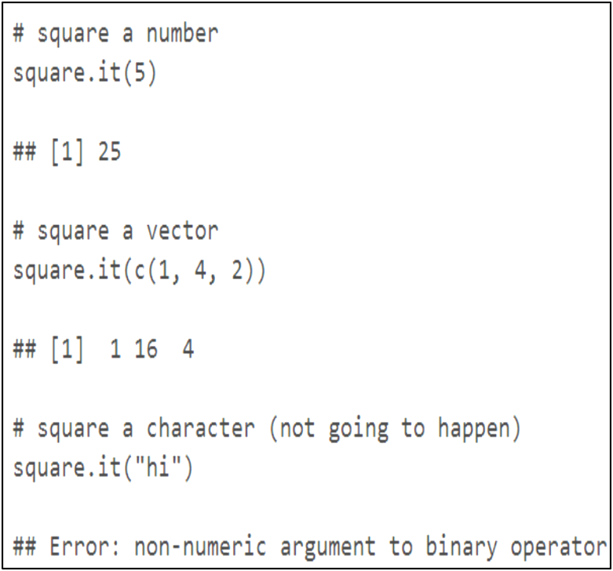
Function()

Slide 52
Function exercise
Write a function to compute the area of a circle with radius of r (area = pi*r^2)

Slide 53
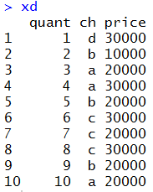
Data processing: with
With
xd<- data.frame(quant=1:10,ch=sample(letters[1:4],10,replace = T),price=sample(c(10000,20000,30000),10,replace = T))

Slide 54
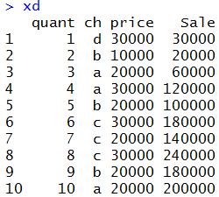
Data processing: with
xd$Sale<-with(xd,price*quant)
xd$Sale<-xd$quant*xd$price

Slide 55
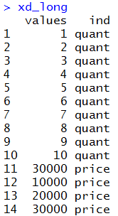
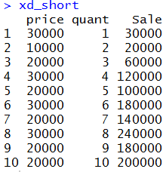
Data processing: stack (unstack)
Stack (unstack): convert data into long (short) data
xd1<-xd[,-2] # ignore character vector
xd_long<-stack(xd1)
xd_short<-unstack(xd_long)

Slide 56
Data processing: aggregate
https://datascienceplus.com/aggregate-data-frame-r/
http://www.cnblogs.com/cloudtj/articles/5528903.html
Aggregate is a function in base R which can, as the name suggests, aggregate the inputted data.frame d.f by applying a function specified by the FUN parameter to each column of sub-data.frames defined by the by input parameter.
The by parameter has to be a list. However, since data.frames are handled as (named) lists of columns, one or more columns of a data.frame can also be passed as the by parameter. Interestingly, if these columns are of the same data.frame as the one inputted as x, those columns are not passed on to the FUN function.
The function to apply has to be able to accept a vector (since it will be called with parts of a column of a data.frame as input).

Slide 57
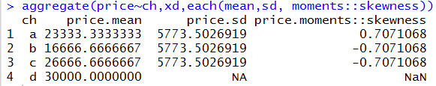
Data processing: aggregate
ifelse(!require(plyr),install.packages("plyr"),library(plyr))
aggregate(price~ch,xd,each(mean,sd, moments))

Slide 58
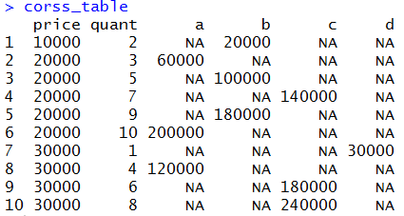
Data processing: dcast
library(reshape2); dcast #(convert data into EXCEL format)
corss_table<-dcast(xd, price+quant~ch,value.var = "Sale")

Slide 59
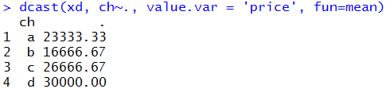
Data processing: dcast
dcast(xd, ch~., value.var = 'price', fun=mean)

Slide 60
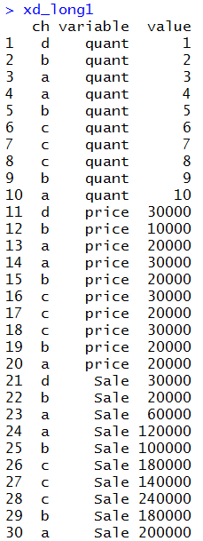
Data processing: melt
xd_long1<- melt(xd, id = 'ch')

Slide 61
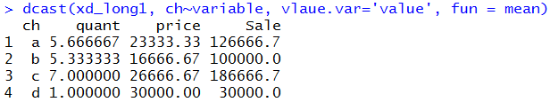
Data processing: melt
dcast(xd_long1, ch~variable, vlaue.var='value', fun = mean)
A good way to use melt is to collapse data into long format and use decast to sort data.

Slide 62
date
date1<-as.Date("2016/07/02","%Y/%m/%d")
date1
[1] "2016-07-02“
date format:
https://stat.ethz.ch/R-manual/R-devel/library/base/html/strptime.html
seq(as.Date("2001/01/01"),as.Date("2016/08/01"),by="month") seq(as.Date("2001/01/01"),as.Date("2016/08/01"),by="quarter")
POSIXct
time1<- now()
time1<- as.POSIXct(time1)
[1] "2016-09-06 11:28:06 CST"

Slide 63
date
library(lubridate)
library(lubridate)
date<-now() [1] "2016-09-06 11:05:28 CST"
second(date) [1] 28.3157
minute(date) [1] 5
hour(date) [1] 11
wday(date) [1] 3
wday(date, label=TRUE, abbr=FALSE) [1] Tuesday
mday(date) [1] 6
yday(date) [1] 250
week(date) [1] 36
month(date) [1] 9
year(date) [1] 2016
date+hours(1)
date+months(1)
date+weeks(1)

Slide 64
Find the third Wed in each month for 2016
date<-Sys.Date()
day(date)<-1 # change date to the beginning of the month
[1] “2016-9-1”
if (wday(date)<=4) {datex<-date+weeks(2)} else {datex<-date+weeks(3)}
datex [1] “2016-9-22”
datex<-datex+days(4-wday(datex))

Slide 65
Reference
C. R. Robert and G. Casella, Introducing Monte Carlo methods with R, 2010, Springer.
http://stackoverflow.com/questions/3505701/r-grouping-functions-sapply-vs-lapply-vs-apply-vs-tapply-vs-by-vs-aggrega
https://aghaynes.wordpress.com/2012/08/10/importing-data-directly-from-ms-excel/
https://www.datacamp.com/community/tutorials/r-tutorial-read-excel-into-r
http://www.r-bloggers.com/how-to-write-and-debug-an-r-function/
http://www.programiz.com/r-programming/
王昭文，運用R語言建置量化投資策略，高雄第一科技大學
Code: Intro_asset_allocation_my.R

